Slide 1
Diabetes Prediction AND Feature Engineering
Capstone Project

Slide 2
Problem statement:
The primary objective of this project is to develop a predictive model that accurately assesses the risk of diabetes in individuals using various health and demographic parameters. This model aims to support healthcare professionals in early diagnosis and preventive care, ultimately reducing the prevalence and impact of diabetes.

Slide 3
Scope:
Utilize a comprehensive dataset containing health metrics such as glucose levels, blood pressure, BMI, age, and lifestyle factors.
Employ machine learning algorithms to analyze patterns and correlations within the data.
Develop a user-friendly tool that provides risk scores for diabetes, aiding in proactive healthcare management.
Expected Outcome:
By leveraging predictive analytics, this project aims to create a reliable and actionable diabetes risk assessment model. This tool will enable healthcare providers to identify high-risk individuals early, facilitating timely interventions and personalized treatment plans to mitigate the progression of diabetes.

Slide 4
Data Dictionary:
Pregnancies: Number of times pregnant (Integer)
Glucose: Plasma glucose concentration after 2 hours in an oral glucose tolerance test (Integer)
BloodPressure: Diastolic blood pressure (mm Hg) (Integer)
SkinThickness: Triceps skinfold thickness (mm) (Integer)
Insulin: 2-Hour serum insulin (mu U/ml) (Integer)
BMI: Body mass index (weight in kg/(height in m)^2) (Float)
DiabetesPedigreeFunction: Diabetes pedigree function (Float)
Age: Age in years (Integer)
Outcome: Class variable (0 or 1), indicating if the person has diabetes (1) or not (0) (Integer)

Slide 5
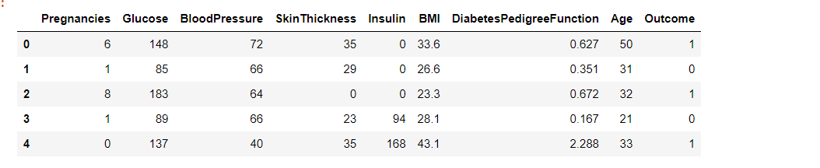
First five Observations

Slide 6
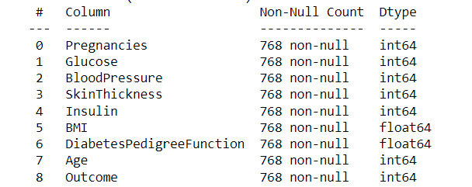
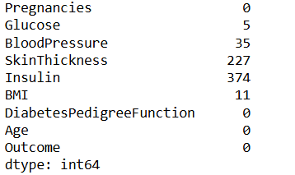
Exploratory Data Analysis (EDA)
Variable Categorization – Detecting the datatypes of variables in data.
Pre-Processing Data Analysis – Missing/NULL values, Redundant data

Slide 7
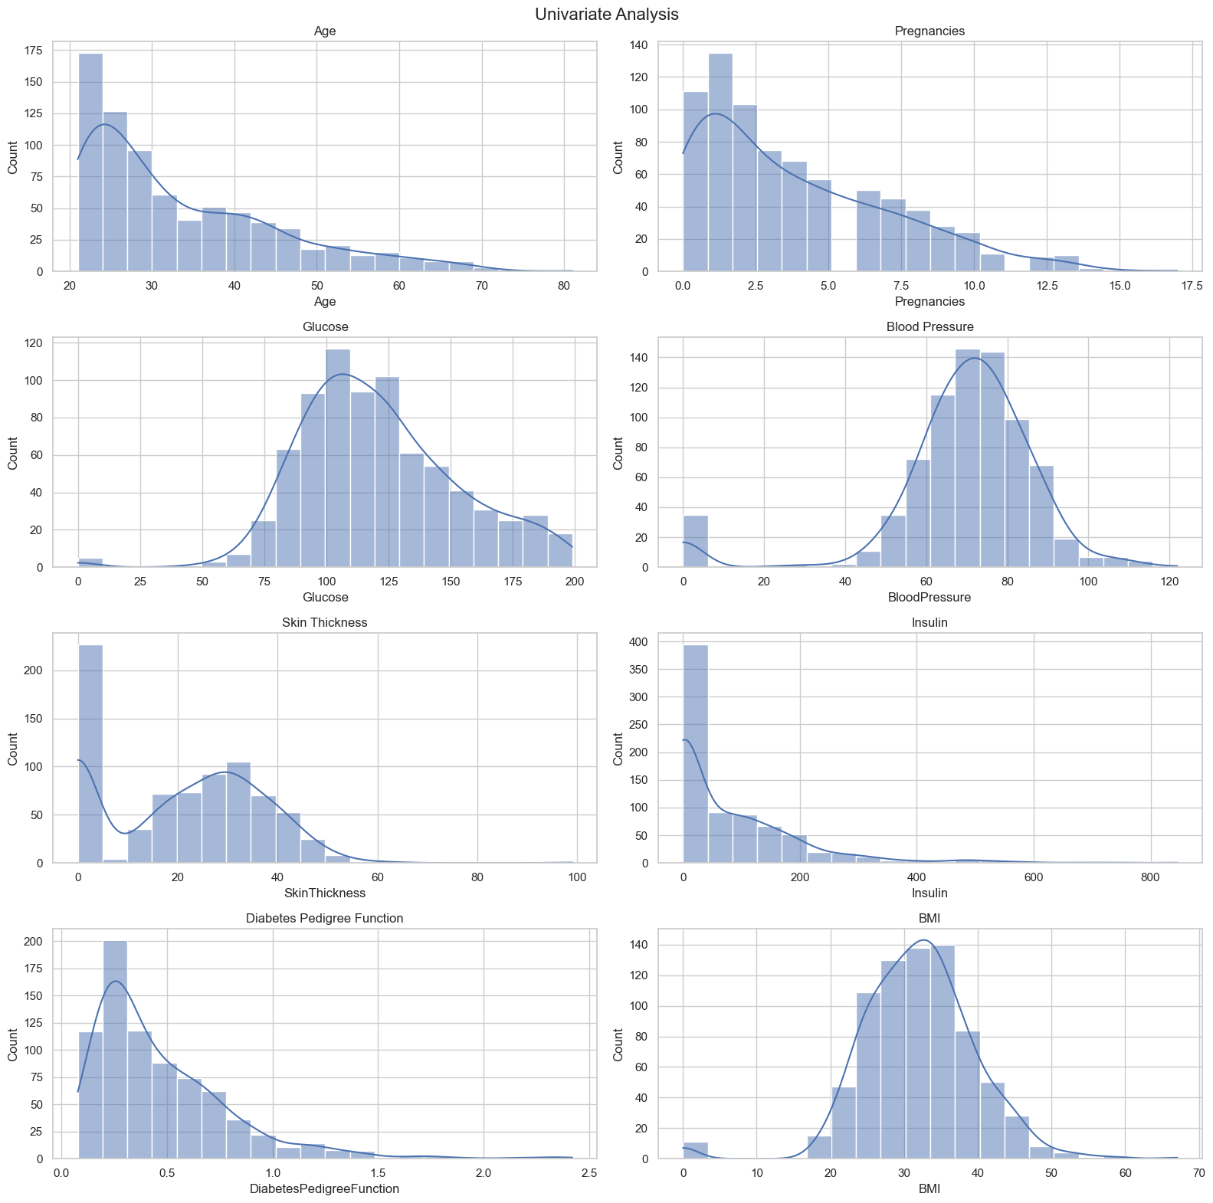
Univariate Analysis

Slide 8
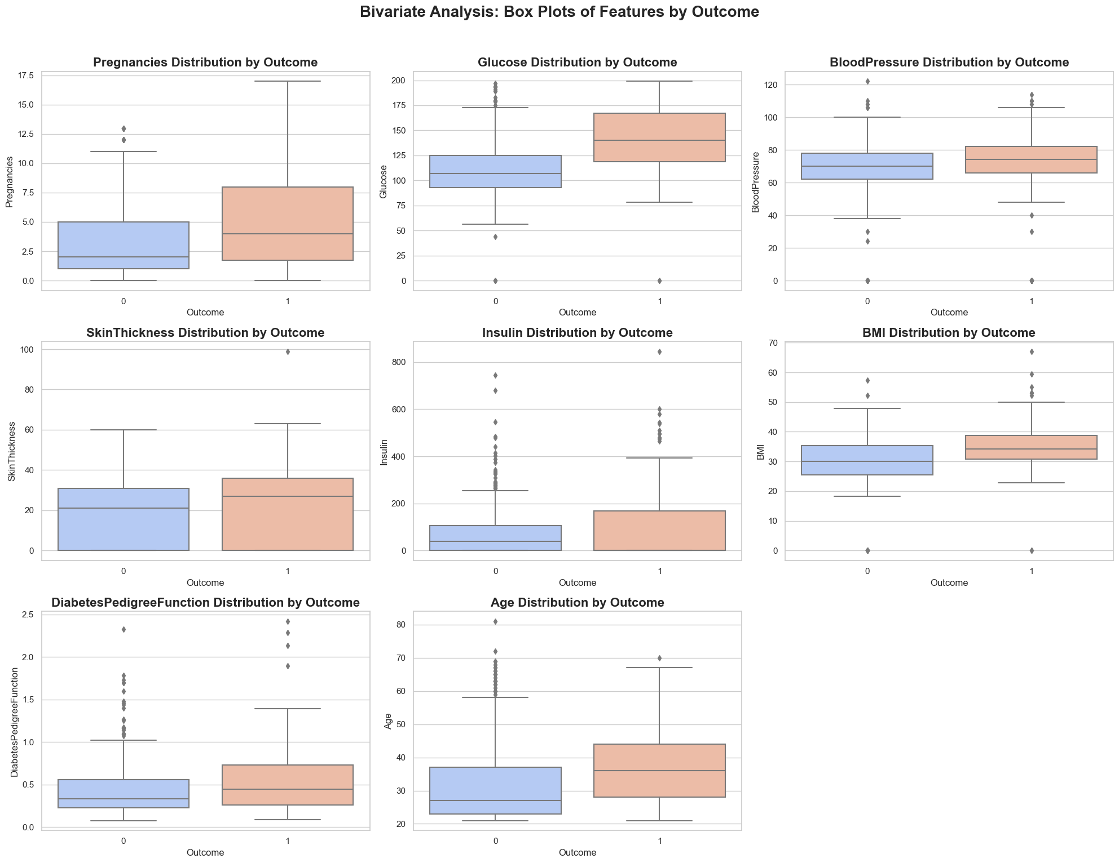
Target Variable Analysis (Bivariate Analysis) –
1. using value_counts()
2. Distribution of target data based on independent variables.
3. Density Distribution

Slide 9
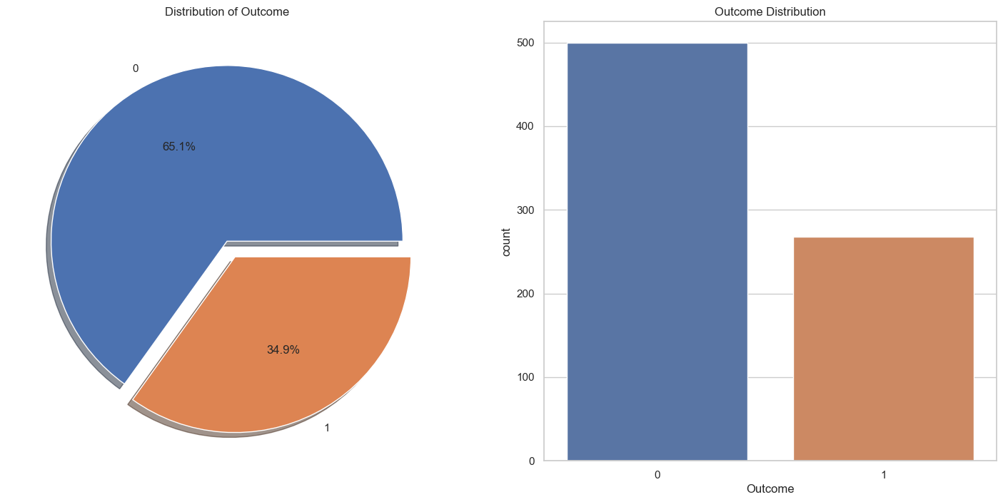
Outcome distribution

Slide 10
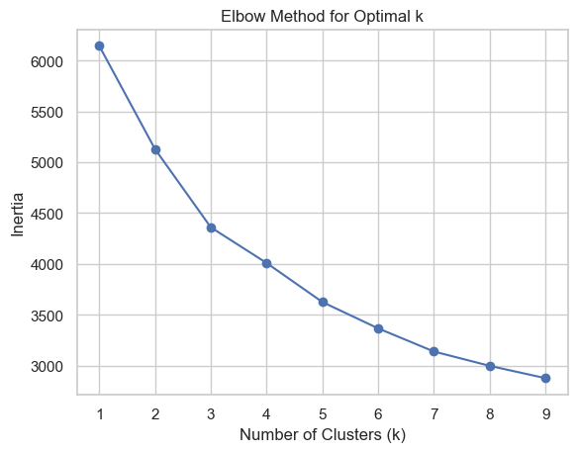
Unsupervised Learning
K = 3

Slide 11
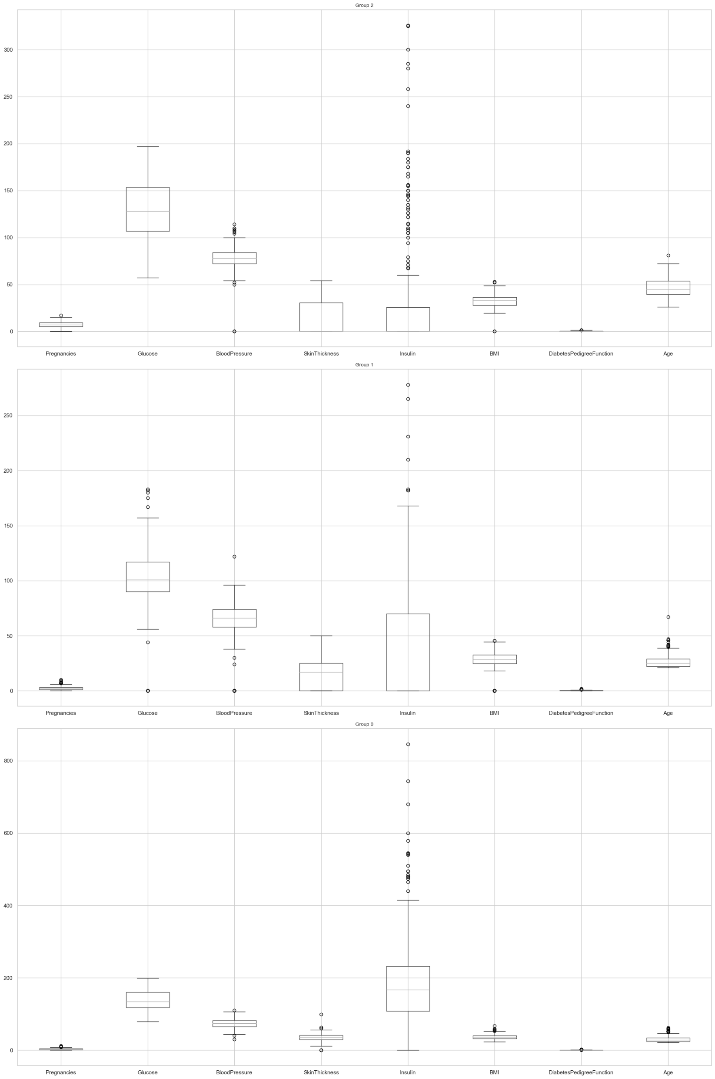

Slide 12
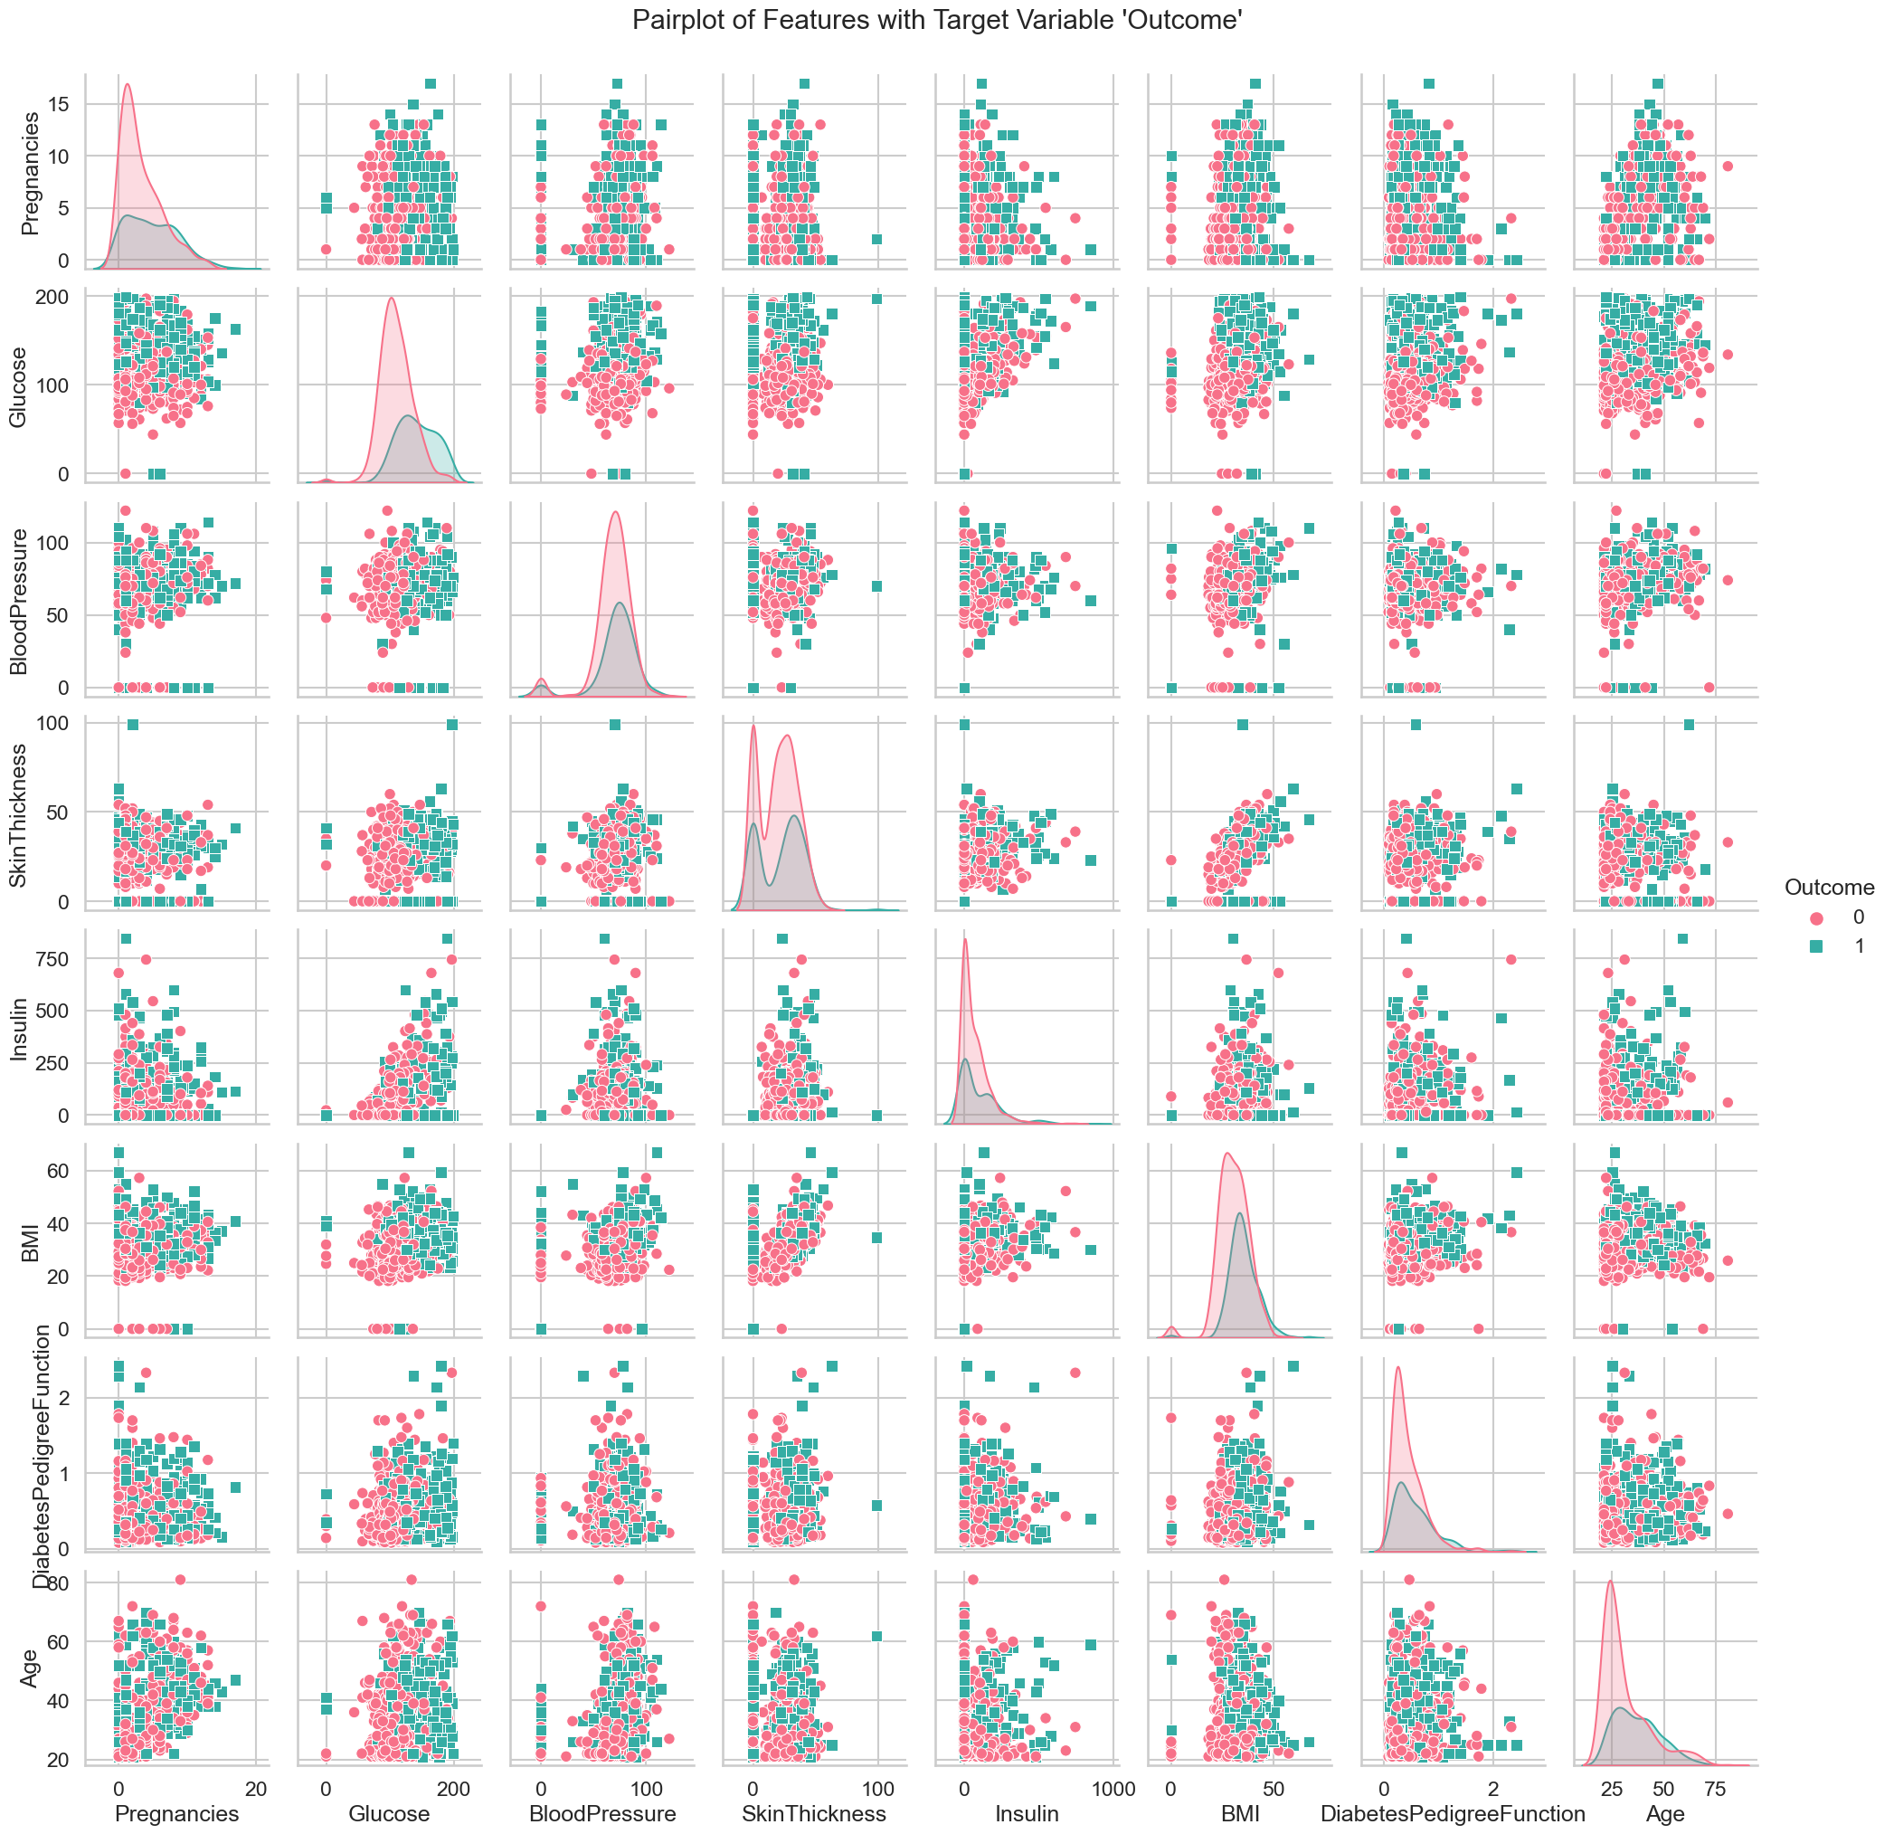
4. Pair Plot:
Pair plot is used in Target variable analysis to understand the distribution of data based on independent variable using scatter plot
It seems like that there is no significant linear relationship or structure between the variables. If the variables appear as clouds or do not show any clear patterns or correlations, it may indeed suggest that performing Principal Component Analysis (PCA) might not be beneficial in this case.

Slide 13
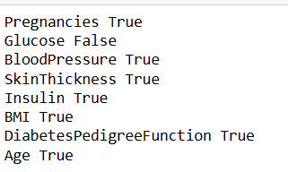
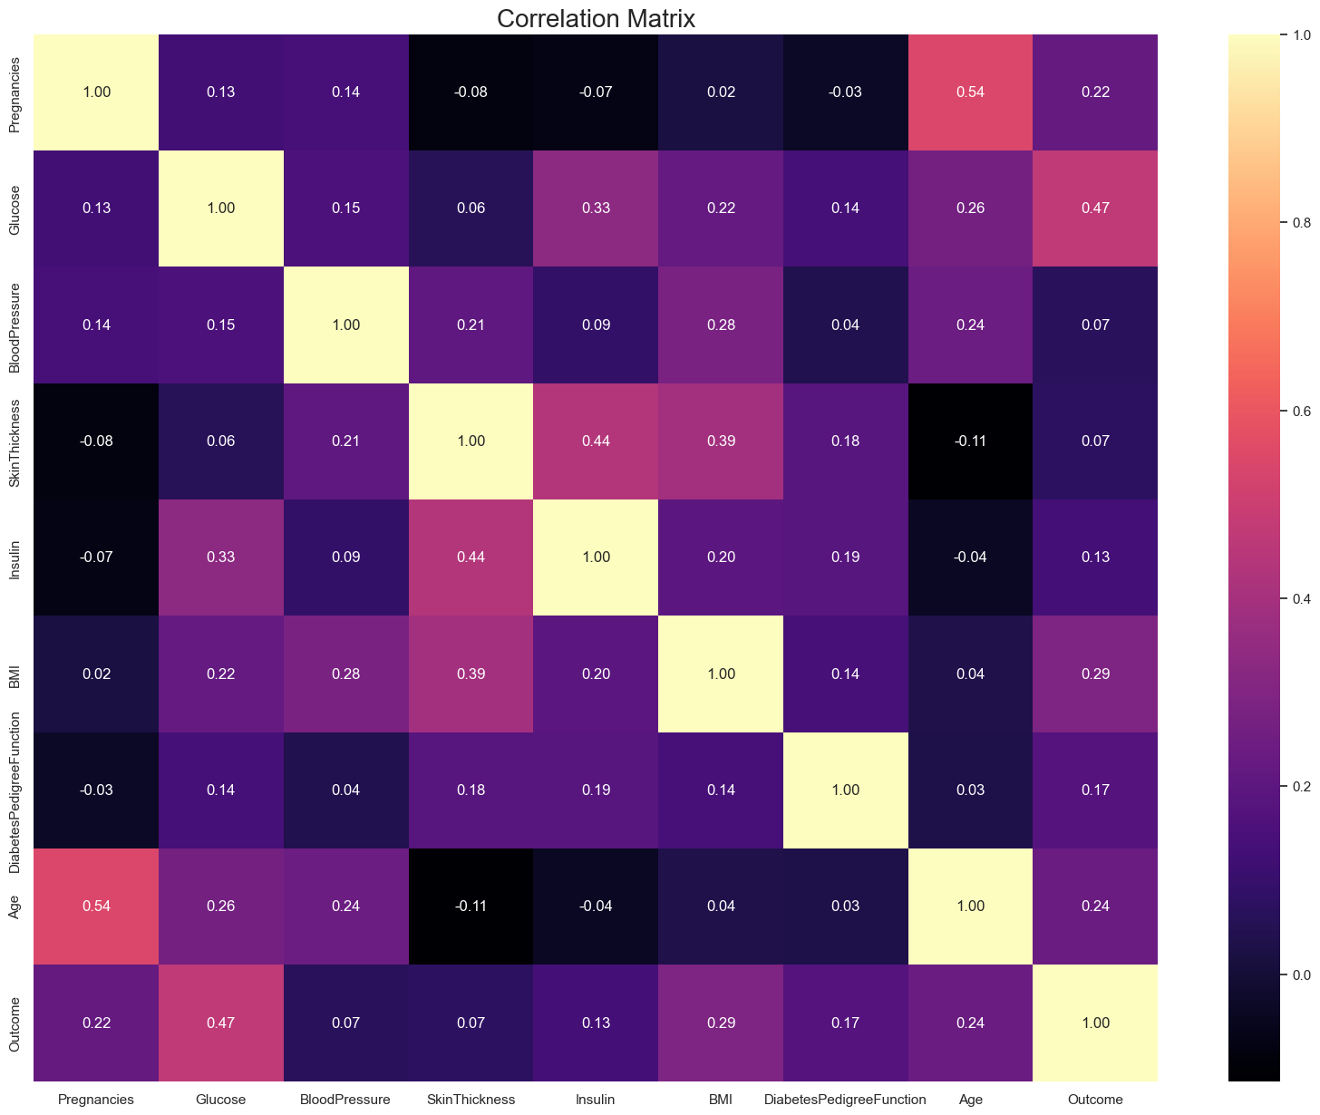
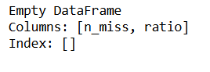
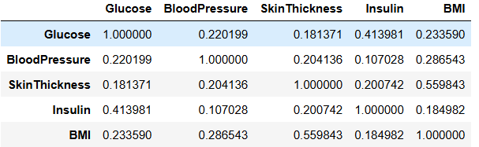
Outlier Analysis – True – Outlier present, False – outlier absent
Missing Value Analysis -
Correlation Analysis -

Slide 14
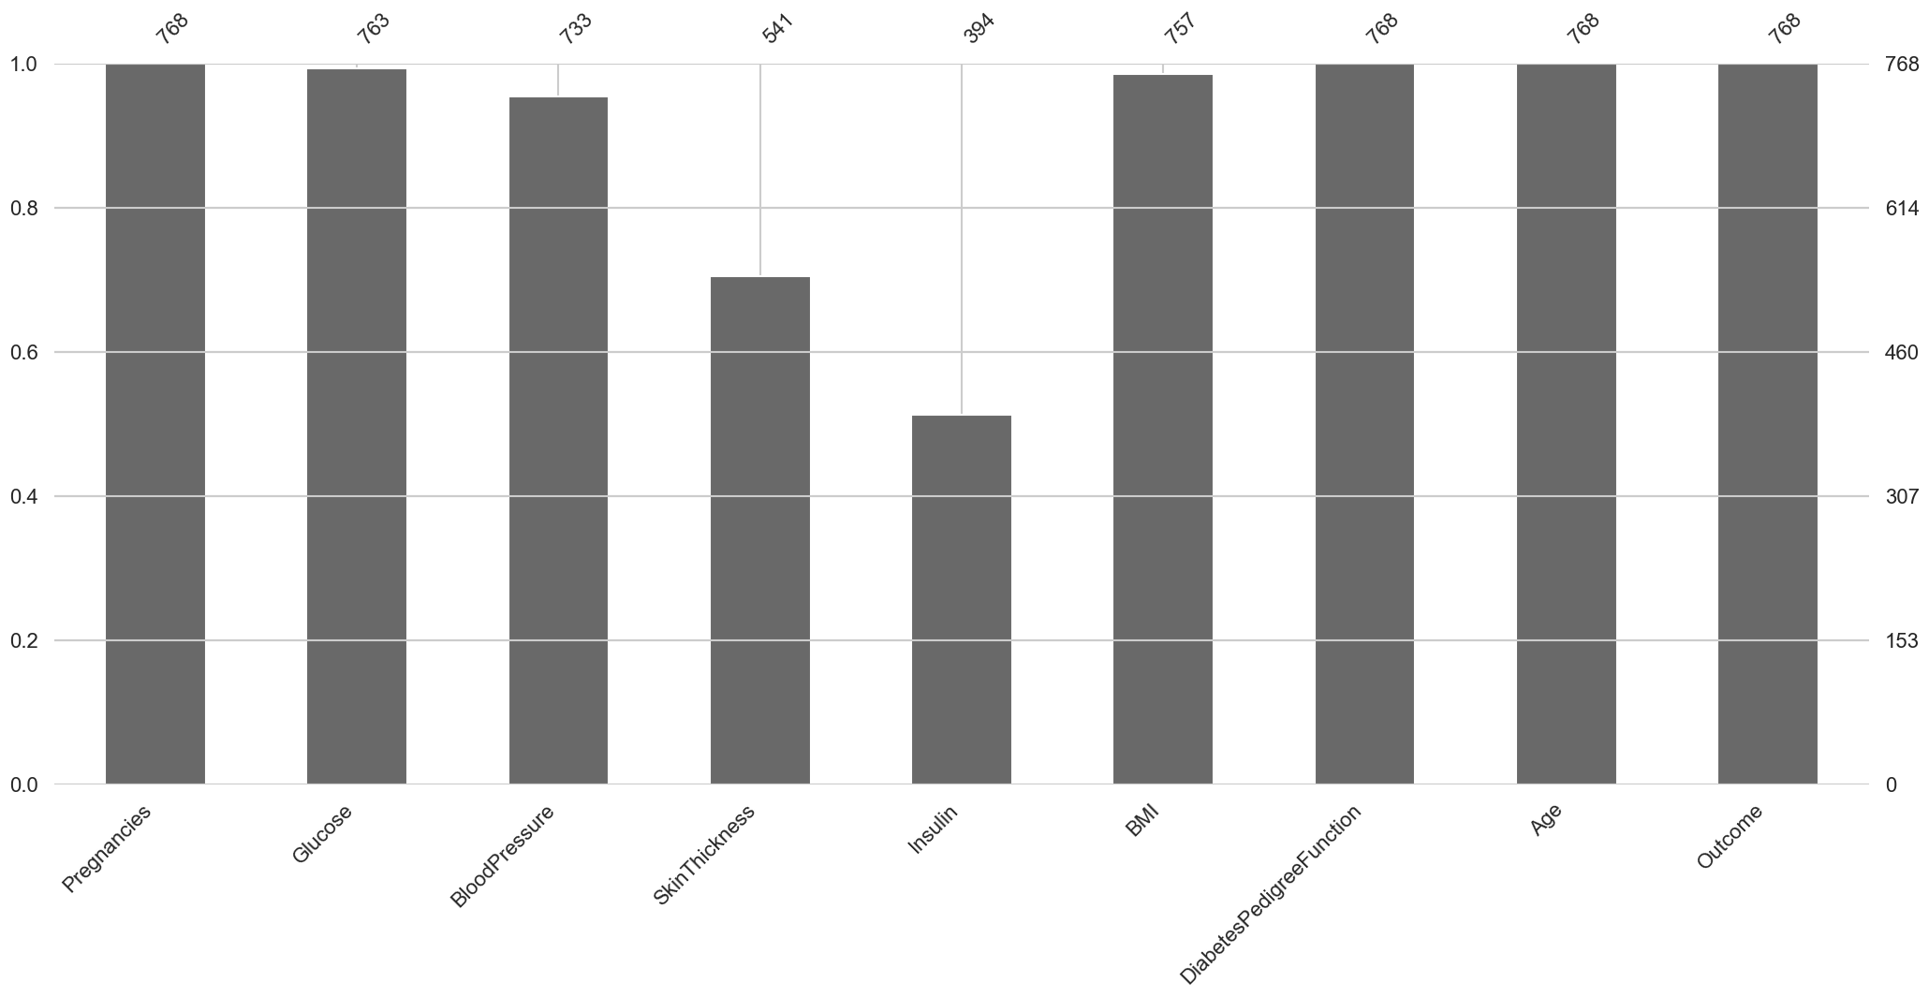
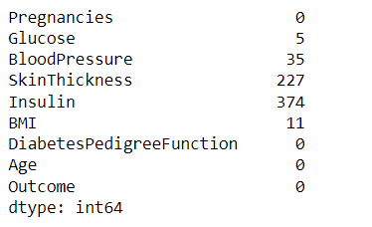
Filling In Median Values
MISSING VALUES
VISUAL REPRESENTATION OF MISSING VALUES

Slide 15
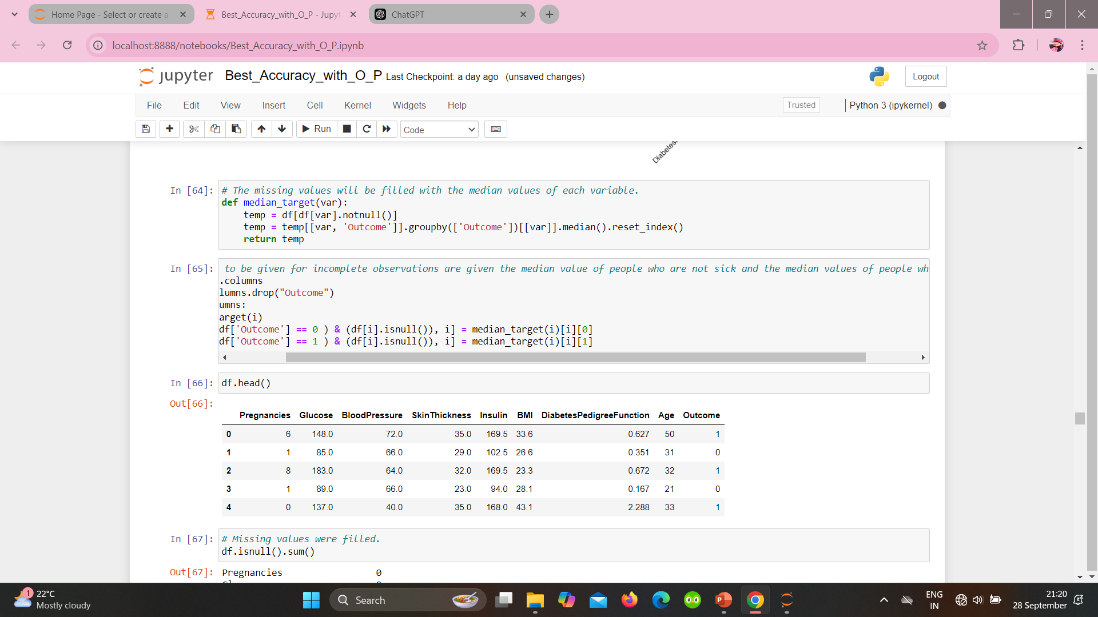
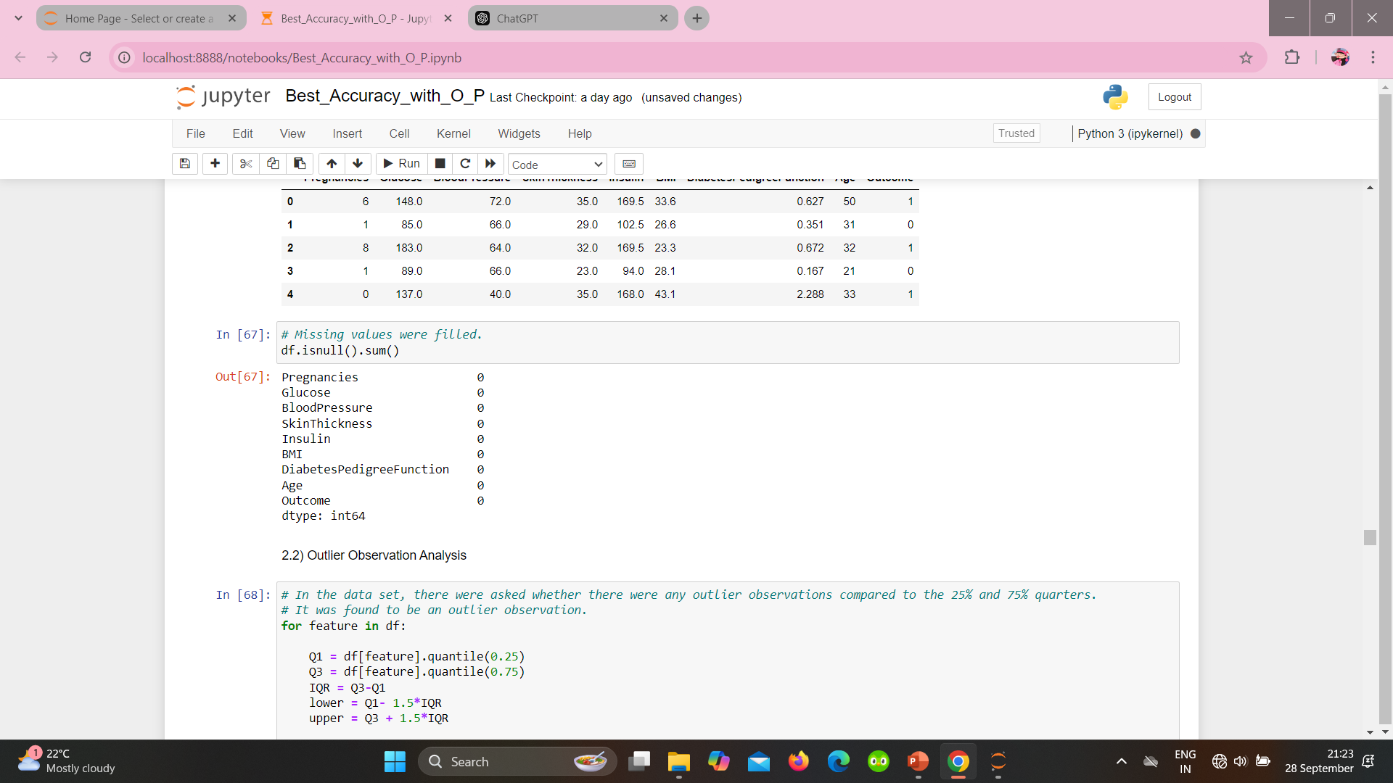
Replacing missing values

Slide 16
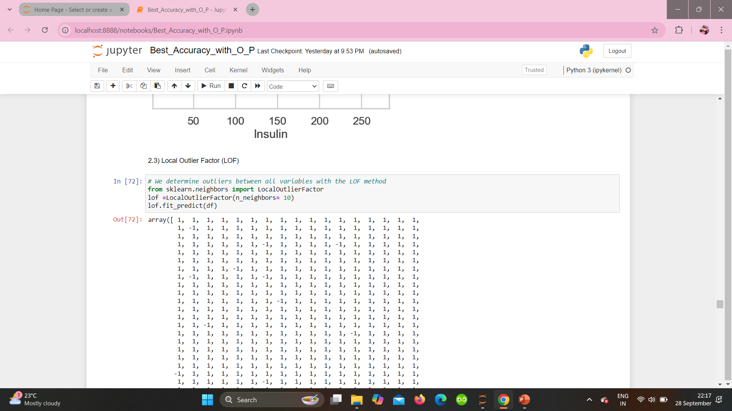
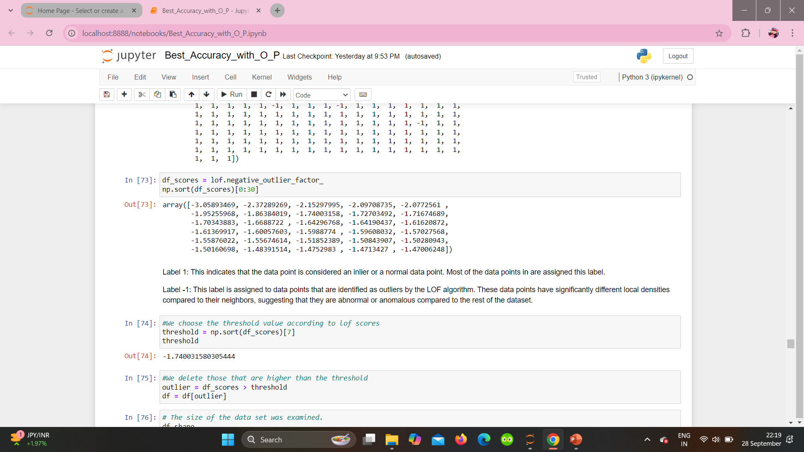
Local Outlier Factor(Dealing with Outliers)

Slide 17
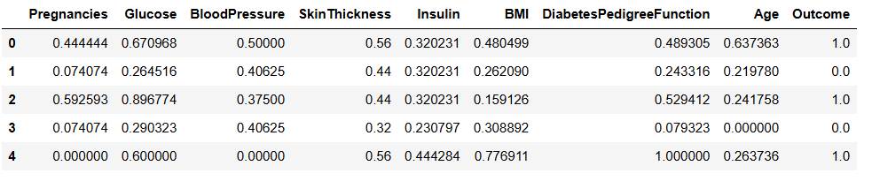
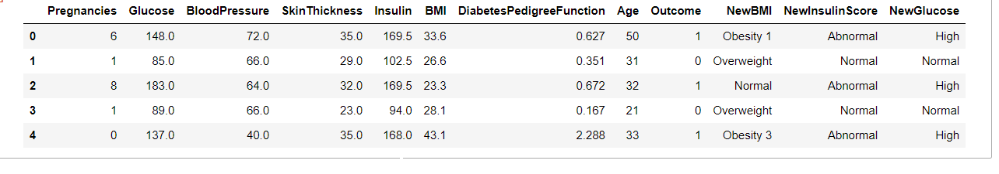
Feature Engineering
Processing for Missing Values and Outliers
Standardization of variables
Added new features, assigned categorical variable.

Slide 18
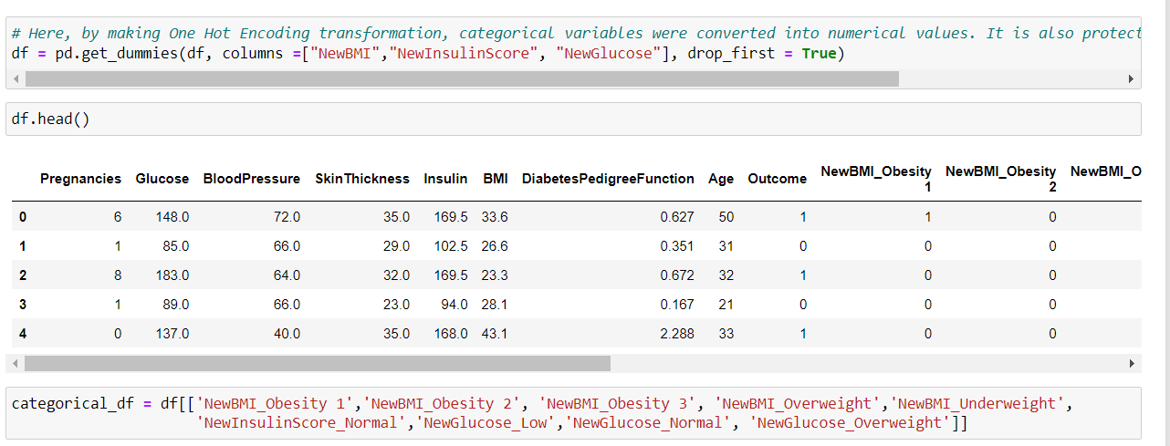
One Hot Encoding

Slide 19
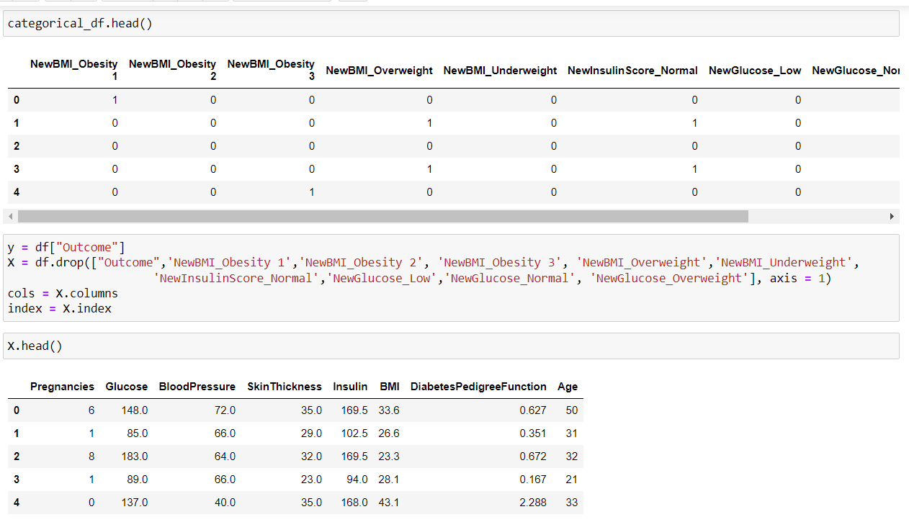
One Hot Encoding

Slide 20
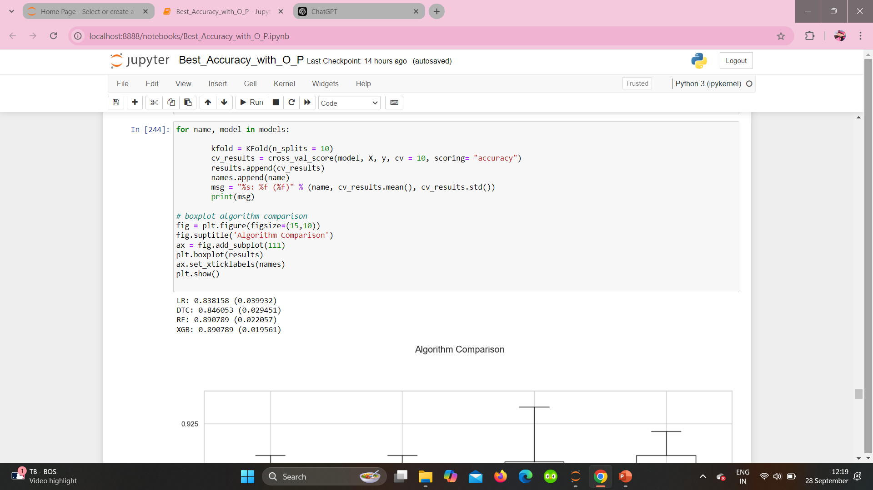
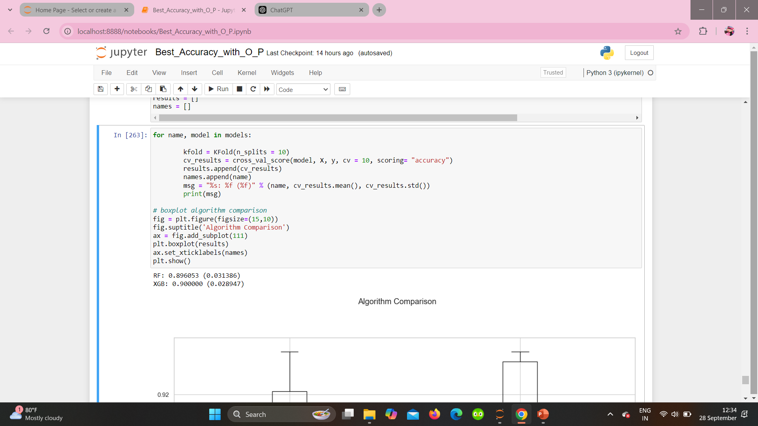
Modelling:
Standardization for Numerical Variables
Create Modelling
1. Splitting data into training and testing data.
2. Used Linear regression.
3. Fit the model to training data.
4. Make predictions to the test data.
5. We tested four models for best accuracy score.
4. Calculate accuracy score as a measure of model performance.

Slide 21
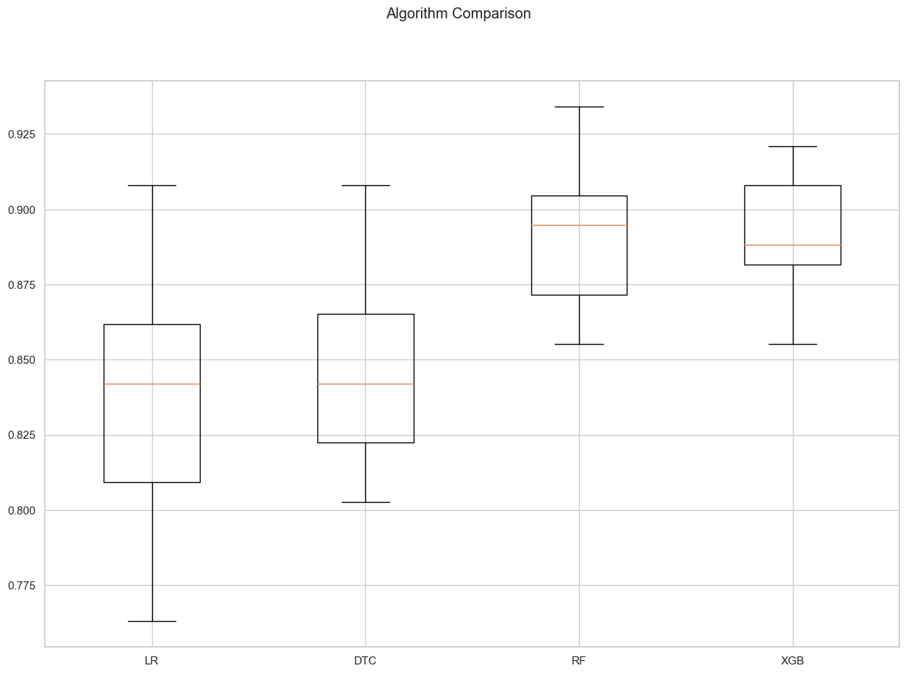
Visual comparison of different models

Slide 22
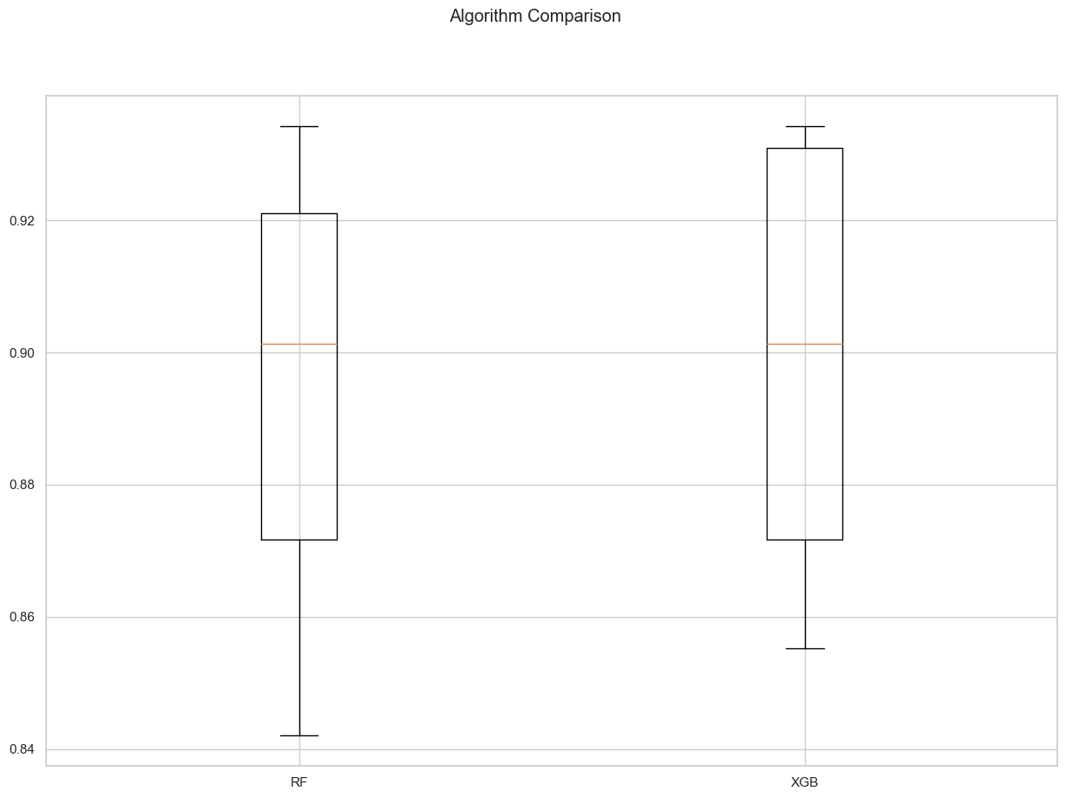
Final model comparison

Slide 23
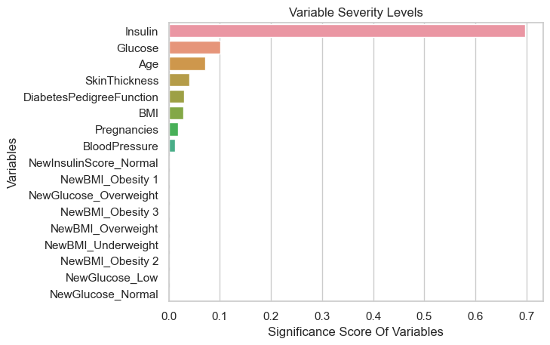
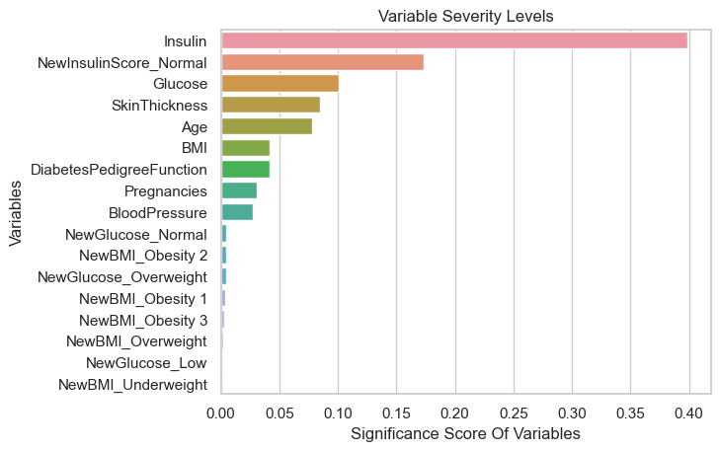
Variable severity level
For RF
For XGB

Slide 24
Conclusion
Conducted comprehensive EDA, extracting valuable insights to enhance data understanding.
Addressed data inaccuracies, ensuring high-quality data for effective model building.
Developed an initial predictive model, evaluated its performance and identifying areas for improvement and improved the model.
“The best-performing model achieved an accuracy of 81.2%.”
The optimal accuracy for a healthcare model should be at least 90% to ensure accurate disease prediction, as it involves life-or-death scenarios.

